Slide 2
Building Line of Business Applications With Silverlight 4
Session Code: PDC09-CL19
David Eitan Poll
Program Manager - Silverlight
Microsoft Corporation
http://www.davidpoll.com

Slide 3
Focus on Data
Interactivity
Entry
Presentation
Navigating a data model
Working with large quantities of data
Editing and adding data
User feedback and validation
Rich UI
Visualization
Common controls

Slide 4
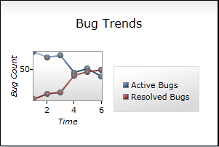
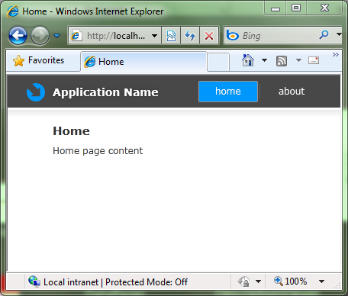
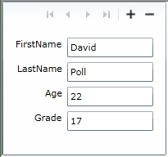
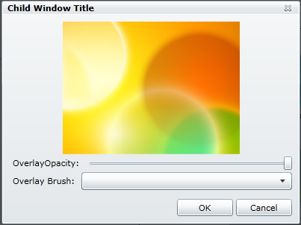
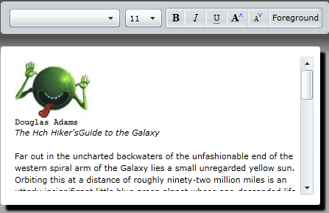
Just a few features in Silverlight…
Notes:
Text smaller (or kill), Images a bit small, and animate in. Clipboard icon.
In order to make SL ready for business, there were a lot of feautres we needed to go do….

Slide 5
What you’ll see…
In this talk:
Silverlight in Visual Studio 2010
Data binding enhancements
Data-related controls enhancements
Input validation
Printing
Valuable, but not in this talk:
Webcam and microphone support
RichTextArea

Slide 6
Goals for this talk
Tour Business-related features in Silverlight
Build a rich business application experience using Silverlight 4
Explore the interactive design experience for Silverlight in VS2010

Slide 7
Rapid LOB Application Development
Demo
An issue tracking application using Silverlight 4

Slide 8
About the App
Issue tracking system (e.g. Visual Studio Team Explorer bug/task tracking)
Screens…
New issue
All issues
Issues assigned to me
Reports
Some pieces already built
Data model
Services for data query and transactions
Parts of the UI

Slide 9
What We’ll Build
A user experience for working with issues
Validation of issue fields during data entry
Printing of issue data and reports

Slide 10
A Few New APIs of Interest
Bindings
BindingBase.FallbackValue, BindingBase.StringFormat, BindingBase.TargetNullValue
Selector (i.e. ListBox, ComboBox)
Selector.SelectedValue, Selector.SelectedValuePath, Selector.SelectedItem, Selector.SelectedIndex
Commanding
ButtonBase.Command, ButtonBase.CommandParameter
CollectionViewSource
CollectionViewSource.GroupDescriptions

Slide 11
Asynchronous Validation Interface
namespace System.ComponentModel
{
public interface INotifyDataErrorInfo
{
event … ErrorsChanged;
IEnumerable GetErrors(string);
bool HasErrors { get; }
}
}
On Binding… Binding.ValidatesOnNotifyDataErrors

Slide 12
Printing API
namespace System.Windows.Printing
{
public class PrintDocument
{
public event … StartPrint;
public event … EndPrint;
public event … PrintPage;
public void Print(); //call from user-initiated code
//(e.g. a button click)
}
}

Slide 13
What you saw in the demo…
Rapid business application development using Silverlight and Visual Studio 2010
A large variety of Silverlight 4 features
Enhancements and new features across the board
Asynchronous and highly flexible validation
How print your data and take it with you

Slide 14
Lots of Business-related features!
Already in Silverlight
New in SL4
Exception-based validation
Controls
Standard forms controls (Button, TextBox, ListBox, etc.)
ValidationSummary
Label
DescriptionViewer
DataGrid
DataForm
DataPager
Navigation and Deep-linking
ChildWindow
Charting
Toolkit
Validation enhancements
IDataErrorInfo
Asynchronous Validation support
Binding enhancements
Binding to string indexers
StringFormat
TargetNullValue
FallbackValue
Bindings on DependencyObjects
CollectionViews
Support for Grouping/Editing
DataGrid enhancements
* Columns
Copy/Paste support
ICommand Support
Selector support
Printing
Right-click support
Clipboard support
Drag/Drop
Rich Text
Webcam/Microphone support
Fluid Layout
And many more!
Notes:
Move Rich Text and Webcam/Microphone support down

Slide 15
Resources
Related Talks:
Silverlight
Microsoft Silverlight Roadmap and Futures (CL01)
Networking and Web Services in Microsoft Silverlight (CL06)
Improving and Extending the Sandbox with Microsoft Silverlight 4 (CL20)
Developing Testable Silverlight Applications (CL32)
More Related Talks:
RIA Services
Building Amazing Business Applications with Microsoft Silverlight and Microsoft .NET RIA Services (CL21)
Mastering Microsoft .NET RIA Services (CL07)
Links
Silverlight.net (http://www.silverlight.net)
Silverlight Toolkit (http://silverlight.codeplex.com)
.NET RIA Services (http://www.silverlight.net/riaservices)
Notes:
(CL20)

Slide 16
Silverlight 4 is ready for business
Final thought…
Build your rich LOB applications quickly and effectively using Silverlight!

