Slide 1
Required Slide

Slide 2
Taking Microsoft Silverlight 4 Applications Beyond the Browser
Required Slide
SESSION CODE: WEB313
David Eitan Poll
Program Manager | Microsoft Silverlight
http://www.davidpoll.com
Microsoft Corporation

Slide 3

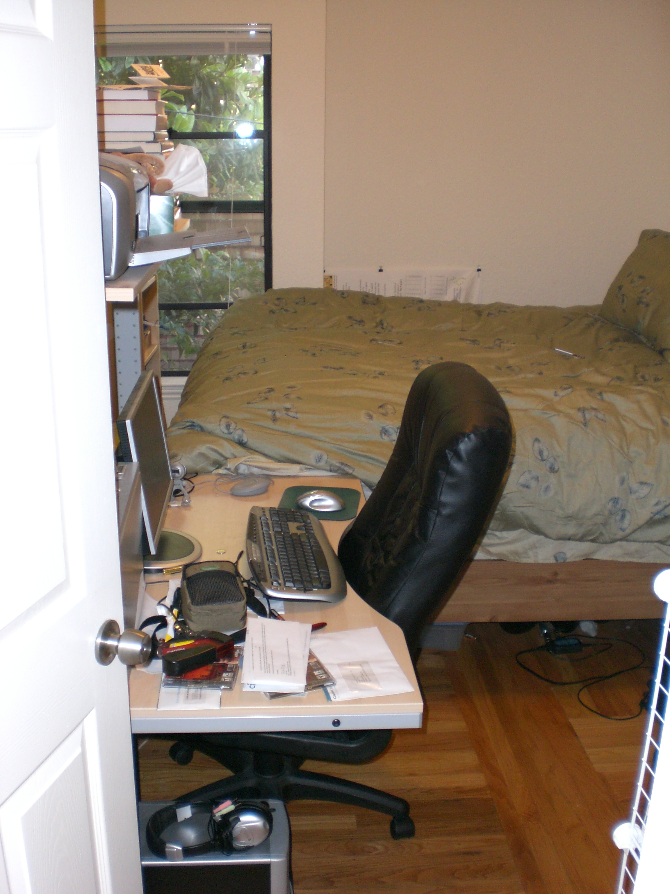
Applications have homes too, you know…
Notes:
“Apartment photo” taken by me (David Poll)
All other art on this page is from the Office 2010 ClipArt gallery.

Slide 4
Agenda
Silverlight 3
Recap
Demos and code
Silverlight 4
New out-of-browser features
Trusted apps
Demos and code
Out-of-browser app support

Slide 5

Why step outside the browser?

Slide 6
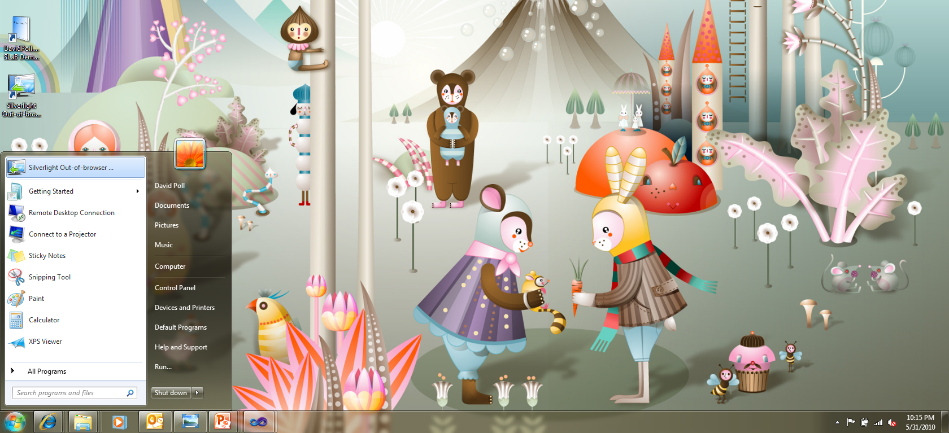
Give apps a proper home

Slide 7

Build immersive
experiences
More options
Notes:
Matryoshka doll
http://www.flickr.com/photos/frangipani_photograph/3066995907
Image courtesy of Frangipani Photograph
License: Creative Commons 2.0 (by-nc-nd)

Slide 8
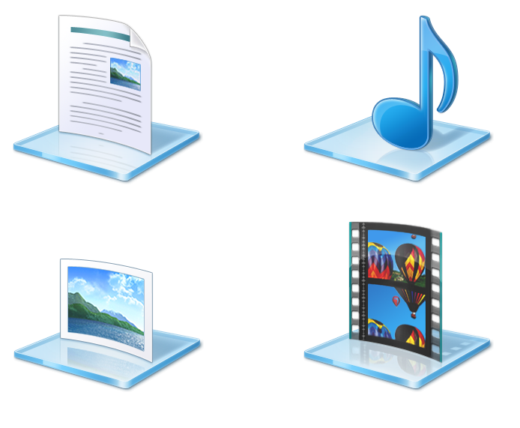
“Put the computation near the data”
- Jim Gray
Harness local data

Slide 9
Silverlight 3 Out-of-browser Apps
Scenario
  Disconnected Silverlight Apps
Features:
  Sandboxed experience
    Run an in-browser App “out of the browser”
  Built in updating model
    Support auto-update and custom updates
  Offline aware APIs
  Network connectivity APIs
  Increased Isolated Storage (25 MB)

Slide 10
Sync Framework
Sync data stored in SQL Server or SQL Azure with Silverlight applications for caching or offline operation.
Persisted, synchronizable collections API on top of isolated storage
Ability to plug-in third party structured stores.
Mid-tier components that expose a sync protocol used to communicate with Silverlight components
  Works with SQL Server or SQL Azure
  On-premises and in the cloud
See sessions on the sync framework for more information
  COS07-INT (interactive session)
  TLC-74 (demo station)

Slide 11
Basic Out-of-browser Application
code | demo

Slide 12
Stepping Beyond the Browser
In Silverlight 4

Slide 13
New in Silverlight 4 Out-of-browser applications
Web Browser hosting
  WebBrowser control
  WebBrowserBrush
Window customizations
Toast notifications
Offline DRM media playback
Silent install/uninstall support
Install-free “emulation mode” run
Trusted Applications

Slide 14
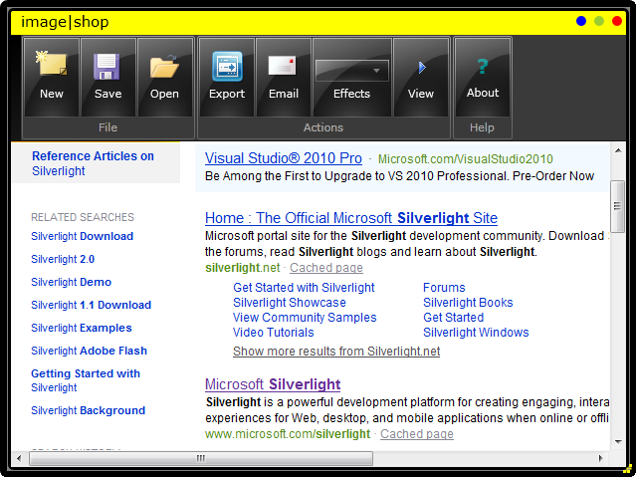
Displaying HTML Content in Out-of-browser Applications
Silverlight
$
Web content

Slide 15
WebBrowser control and the WebBrowserBrush
WebBrowser Control
  Supported Outside of the Browser
    In browser, use the browser
  Navigate to URL or set content as a string
  “Windowed” hosting with interoperability
  Supports browser plug-ins and doc objects
    E.g. PDF, XPS, Flash, Silverlight, etc.
WebBrowserBrush
  Enables layering of HTML and Silverlight
  HTML content is not-interactive
  Refreshes display on-demand (not automatically)

Slide 16
Web Browser Demo
Getting started with the WebBrowser control and WebBrowserBrush
code | demo

Slide 17
WebBrowser Control and WebBrowserBrush
<WebBrowser x:Name="webBrowser"
ScriptNotify="webBrowser_ScriptNotify"
LoadCompleted="webBrowser_LoadCompleted"
Source="http://any.site" />
<Rectangle Grid.Row="1"
Name="rectangle1">
<Rectangle.Fill>
<WebBrowserBrush x:Name="brush"
SourceName="webBrowser"
Opacity="0.5" />
</Rectangle.Fill>
</Rectangle>

Slide 18
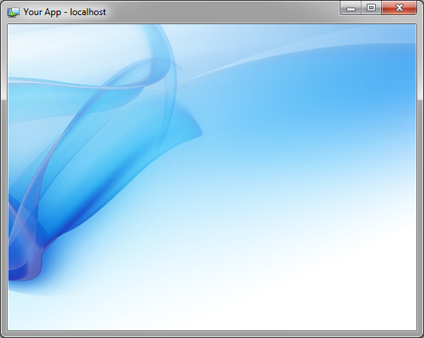

Window Customization
top, left
Startup location
Dimensions of client area
TopMost
Activate() and IsActive
Close() and Cancellable Closing event
height
width
topmost

Slide 19


Notification Window (a.k.a. “Toast”)
Rectangular
400 x 100 px max
30 sec. max
Can activate main window
You have 325 new voicemails
x
Listen

Slide 20
Notification Window usage
NotificationWindow toast = new NotificationWindow();
toast.Content = new ToastContent();
toast.Content.MouseLeftButtonUp += (s, arg) =>
{
Application.Current.MainWindow.Activate();
};
toast.Show(4000);

Slide 21
Rich Out-of-Browser Experiences
Window customization and notification window demo
code | demo

Slide 22
Offline DRM Content Playback
New Business Models
Subscription
Rental
Purchase
New Features
Persistent license storage
Time based policies
Secure H.264 and AAC decoders
Support for Output Protection

Slide 23
Application installation options
Enterprise installs silently via scripts, installers, or executables
Launch without installing (For developer tools or if deploying via CD, DVD, USB media, etc.)
sllauncher.exe /install:"somePath\myApp.xap"
/origin:"http://any.site.com/myApp.xap"
/shortcut:desktop+startmenu
/overwrite
sllauncher.exe /uninstall
/origin:"http://any.site.com/myApp.xap"
sllauncher.exe /emulate:"somePath\myApp.xap"
/origin:"http://any.site.com/myApp.xap"
/overwrite
Platform Specific Usage

Slide 24
Trusted Applications

Slide 25
Trusted Silverlight Out-of-browser Applications
Not all Apps can play in the Sandbox
  Some need generally unsafe operations
    Office export, device access, file system access
  Some need a bigger Sandbox
    Speech APIs, USB/Volume access
Trusted Applications are not Sandboxed
  Enabled in Silverlight 4 by:
    Specific elevated trust features
    These features are enabled via a deployment option
  Install requires users to “trust” the application

Slide 26
Trusted Application Features
Relax sandbox speed bumps
File System Access
Native Integration
Custom Window Chrome
Digitally signed XAPs

Slide 27
Relaxed Sandbox Speed Bumps
Enable cross domain HTTP networking
Eliminate socket port range restrictions
Full path in Open/SaveFileDialog
Eliminate user initiation requirement:
  Open/FileSaveDialog
  Clipboard access
  Full screen mode
  Changing window settings
Enable full keyboard in full-screen mode

Slide 28
File System Access
Access to “My Files”
  Documents
  Pictures
  Music
  Videos
Types from System.IO
  File
  Directory
  Environment
  Etc.

Slide 29
File System Access (creating a new video file)
// defensive code == portable code
if (Application.Current.HasElevatedPermissions)
{
// look ma, no path hard-coding!
// this code works on Mac, Windows, everywhere
string path = Environment.GetFolderPath(
Environment.SpecialFolder.MyVideos);
string mediaFile = Path.Combine(path, "Foo.mp4");
if (!File.Exists(mediaFile))
{
using (FileStream fs = File.Create(mediaFile))
{
//...
}
}
}

Slide 30
Window Chrome Customization
Remove the Shell chrome and window border
Rectangular window
Rectangular window with rounded corners

Slide 31
COM Automation
Enables platform specific code
  Two “platform” specific APIs in Silverlight
    ComAutomationFactory.CreateObject
    ComAutomationFactory.GetObject
Automation objects on Windows
  Late bound COM (IDispatch)
  C# 4.0 “dynamic” programming model
  Standard language feature in Visual Basic
Silverlight will not install native components
  Components must be already installed or use a separate native installer

Slide 32
COM Automation Details
Supported in Silverlight 4
Property get/set, indexed property get/set
Positional and optional parameters
Support by-ref and by-value
In proc and out of proc servers
Support for basic data types
VARIANT, BSTR, SAFEARRAY, IEnumVARIANT
Silverlight app as event sink
Not in Silverlight 4
Multi-dimensional arrays
Named parameters
Type Information
Support for COM Elevation moniker

Slide 33
COM Automation Usage (adding an Excel workbook)
// defensive code == portable code
if (AutomationFactory.IsAvailable)
{
dynamic xl = AutomationFactory.CreateObject("Excel.Application");
xl.Visible = true;
xl.Workbooks.Add();
//...
}

Slide 34
Trusted Application Demo
Local file system access, custom window chromes, and COM automation
code | demo

Slide 35
Digital Signing of XAPs
Highly
Recommended
For Consumers
Reassurance on authenticity and integrity of app
Clear publisher and provenance info on app
For App Developers
Better install-time UX
App Icon
Publisher name
Seamless updates
No updates for unsigned apps
No updates when certs mismatch

Slide 36
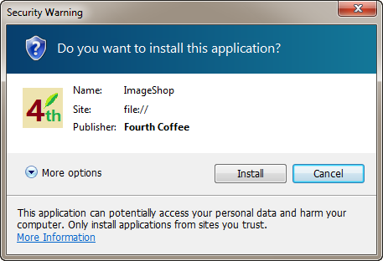
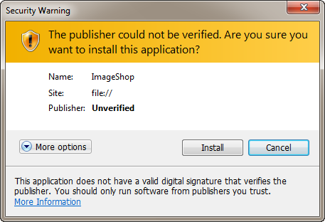
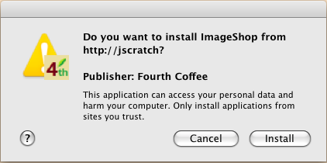
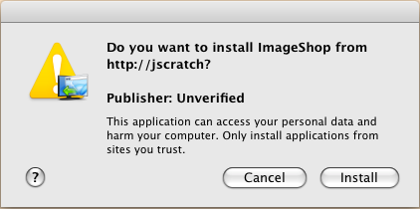
Digitally-signed trusted app install experience
Valid, Signed XAPs
Unsigned or Self-signed XAPs

Slide 37
Trusted Applications… Things to Remember
No trusted operations possible within the browser
Per-user app, not system-wide
Runs with standard user privileges, not admin
  Great defense in depth with UAC on [recommended!]
No consent → No trust → No install
Group Policy hooks to disable install, activation
With great power comes great responsibility
  Set expectations with users
  Sign your XAPs!

Slide 38
With Silverlight…
Make your apps “feel at home”
Build “sticky” desktop experiences
Gain access to more features by running out-of-browser
Harness local data and provide immersive, latency-free experiences
  …by putting the computation near the data

Slide 39
Silverlight’s App Model Evolution
v1.0
2
3
4
XAML + JavaScript
XAP and managed code
Beyond the browser
Trusted apps
Thank you!

Slide 40
Track Resources
Required Slide
Track PMs will supply the content for this slide, which will be inserted during the final scrub.
Resource 1
Resource 2
Resource 3
Resource 4

Slide 41




Resources
Required Slide
Learning
  Sessions On-Demand & Community
  Microsoft Certification & Training Resources
www.microsoft.com/teched
www.microsoft.com/learning
  Resources for IT Professionals
  Resources for Developers
http://microsoft.com/technet
http://microsoft.com/msdn

Slide 42
Related Content
Required Slide
Speakers, please list the Breakout Sessions, Interactive Sessions, Labs and Demo Stations that are related to your session.
Breakout Sessions
  WEB205 | Unit Testing in Microsoft Silverlight
  WEB307 | Effective RIA: Tips and Tricks for Building Effective Rich Internet Applications
Interactive Sessions
  COS07-INT | Using Microsoft SQL Azure as a Datahub to Connect Microsoft SQL Server and Silverlight Clients
Product Demo Stations
  TLC-23 | Microsoft Silverlight
  TLC-74 | Microsoft SQL Azure Data Sync

Slide 43



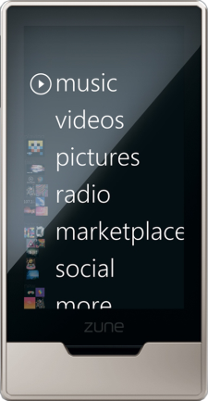
Required Slide
Complete an evaluation on CommNet and
enter to win!

Slide 44
Questions?

Slide 45


© 2010 Microsoft Corporation. All rights reserved. Microsoft, Windows, Windows Vista and other product names are or may be registered trademarks and/or trademarks in the U.S. and/or other countries.
The information herein is for informational purposes only and represents the current view of Microsoft Corporation as of the date of this presentation. Because Microsoft must respond to changing market conditions, it should not be interpreted to be a commitment on the part of Microsoft, and Microsoft cannot guarantee the accuracy of any information provided after the date of this presentation.
MICROSOFT MAKES NO WARRANTIES, EXPRESS, IMPLIED OR STATUTORY, AS TO THE INFORMATION IN THIS PRESENTATION.

Slide 46
Credits
Matryoshka doll
  http://www.flickr.com/photos/frangipani_photograph/3066995907
  Image courtesy of Frangipani Photograph
  License: Creative Commons 2.0 (by-nc-nd)
Special thanks to:
  Joe Stegman & Ashish Shetty (for large amounts of content)
  Clip-art (for photos of homes I wish I lived in ☺)

